Slide 1
Initial Setup with Docker Lab-session 0
Computer Vision and Image Processing
Prof: Luigi di Stefano - luigi.distefano@unibo.it Tutors: Pierluigi Zama Ramirez - pierluigi.zama@unibo.it Riccardo Spezialetti – riccardo.spezialetti@unibo.it

Slide 2
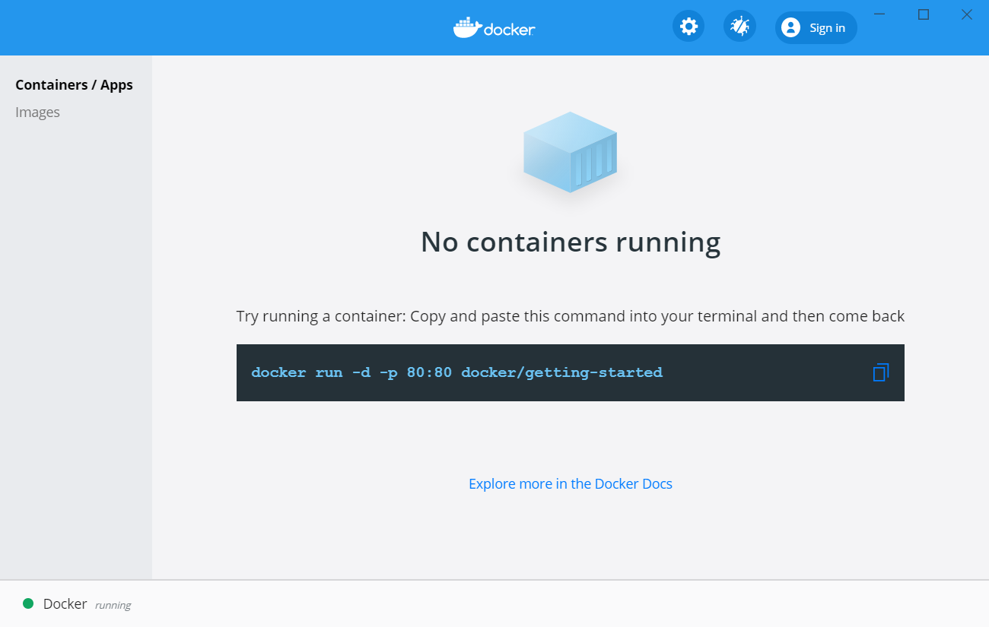
Step 1: Installing and running Docker
What is Docker? Docker is a tool designed to make it easier to create, deploy, and run applications by using containers.
More details at: https://www.docker.com/
Install and Run Docker on Windows
Install Docker on Ubuntu
Follow the instruction at the following link: https://docs.docker.com/docker-for-windows/install/
Run the Docker Desktop application
Follow the instruction at the following link. Installation from repository is recommended. https://docs.docker.com/engine/install/ubuntu/

Slide 3
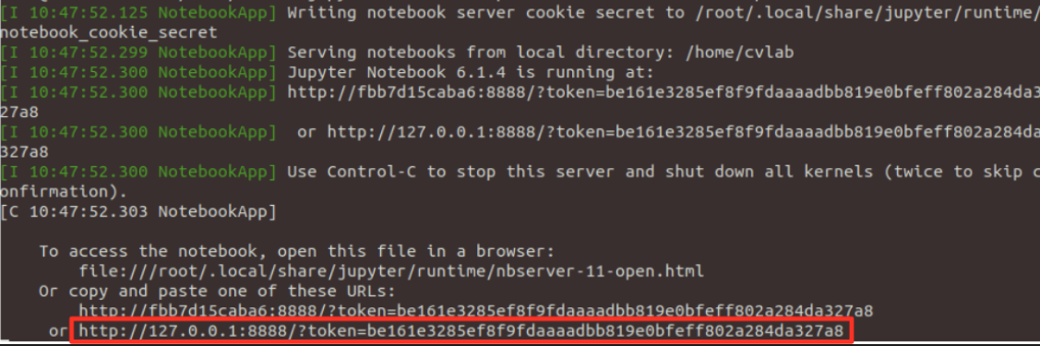
Step 2: Build and Run Docker Container
Download the Dockerfile configuration file
Open a terminal and navigate to the directory containing the configuration file
Execute the following command to build the docker container:
Download the Lab Session .zip file and unzip it. Remember the path to the unzipped folder path:
Execute the following command to run docker container (In Windows explicitly write the PATH_TO_EXERCISES ):
Click or copy link highlighted in the following picture to open the notebook:
docker build . -t cvlab
PATH_TO_EXERCISES=/path/to/excercise
docker run -v ${PATH_TO_EXERCISES}:/home/cvlab -p 8888:8888 cvlab:latest

Slide 4
[OPTIONAL] Connect your webcam to Docker Container (Only Ubuntu)
Docker cannot recognize devices outside from the container. We must explicitly show the device when running the container.
In Ubuntu is quite straightforward. At step 5 of the previous slide, when running the docker container, we run the following command instead:
In Windows we recommend the following guide:
https://docs.microsoft.com/en-us/virtualization/windowscontainers/deploy-containers/hardware-devices-in-containers
docker run -v ${PATH_TO_EXERCISES}:/home/cvlab -p 8888:8888 --device=/dev/video0:/dev/video0 -it cvlab:latest

